Slide 1
Exercise - Learning Objectives
By the end of this exercise you will be able to:
Define a requirement for capacity reserve
Define the fuel for which capacity reserve is needed
Define capacity credits for each technology type

Slide 2
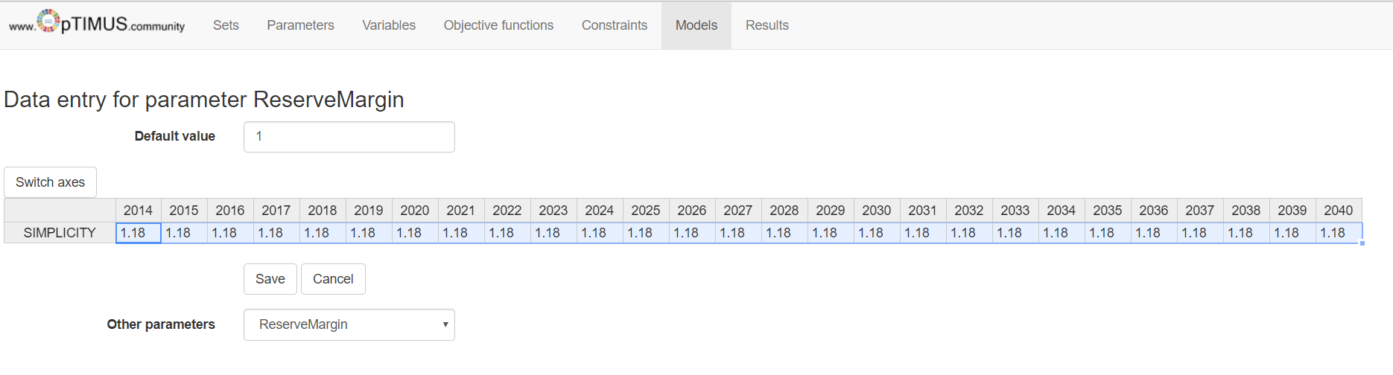
Defining reserve margin requirements
The first step is to decide to what level the reserve margin should be set.
Input a ReserveMargin of 1.18 for all years, indicating that there should be enough capacity reserve to satisfy a theoretical demand level at least 18% above the annual peak demand.

Slide 3
Implementing a capacity reserve
The following parameters should be taken into account
ReserveMarginTagFuel: defines the fuel for which we would like to have adequate capacity reserve.
ReserveMarginTagTechnology: defines the level at which each technology can contribute to the capacity reserve. A value of 1 indicates 100% contribution of a technology’s capacity, while 0 indicates a 0% contribution. Typically, dispatchable thermal power plants and storage options have a contribution of 100%, while non-dispatchable technologies (e.g. Wind and Solar PV) contribute based on their respective availability.

Slide 4
Implementing a capacity reserve
Since the FUEL SEC_EL represents electricity being generated by the power plants, we can indicate that the reserve margin needed is at this level.
ReserveMarginTagFuel: Insert the following values
Fuel | 2014 | 2015 | 2016 | 2017 | 2018 | 2019 | 2020 | 2021 | 2022
SEC_EL | 1 | 1 | 1 | 1 | 1 | 1 | 1 | 1 | 1
 | 2023 | 2024 | 2025 | 2026 | 2027 | 2028 | 2029 | 2030 | 2031
SEC_EL | 1 | 1 | 1 | 1 | 1 | 1 | 1 | 1 | 1
 | 2032 | 2033 | 2034 | 2035 | 2036 | 2037 | 2038 | 2039 | 2040
SEC_EL | 1 | 1 | 1 | 1 | 1 | 1 | 1 | 1 | 1

Slide 5
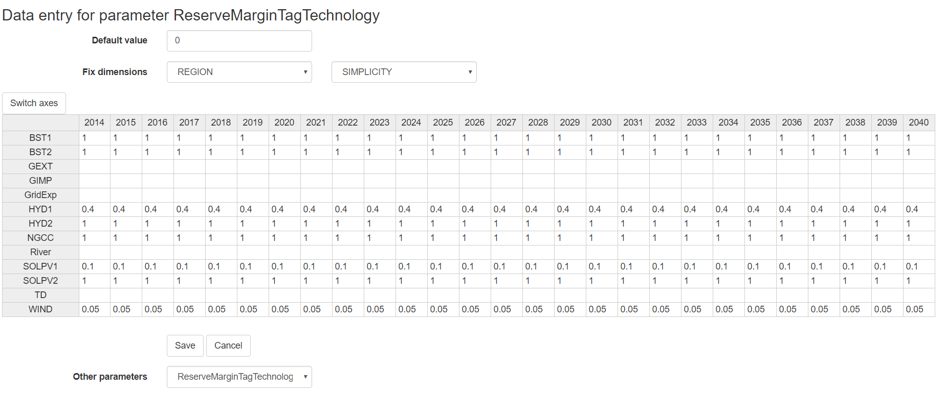
Implementing a capacity reserve
The final step is to define the contribution of each technology (i.e. capacity credit) to satisfying the reserve margin.
ReserveMarginTagTechnology: Insert the following for 2014-2040.
Technology | 2014-2040
NGCC | 1
SOLPV1 | 0.1
SOLPV2 | 1
WIND | 0.05
HYD1 | 0.4
HYD2 | 1
BACKSTOP1 | 1
BACKSTOP2 | 1
Notes:
Mention that the peak demand coincides with the peak generation of PV, hence the allocation of capacity credits despite it not being dispatchable.

Slide 6
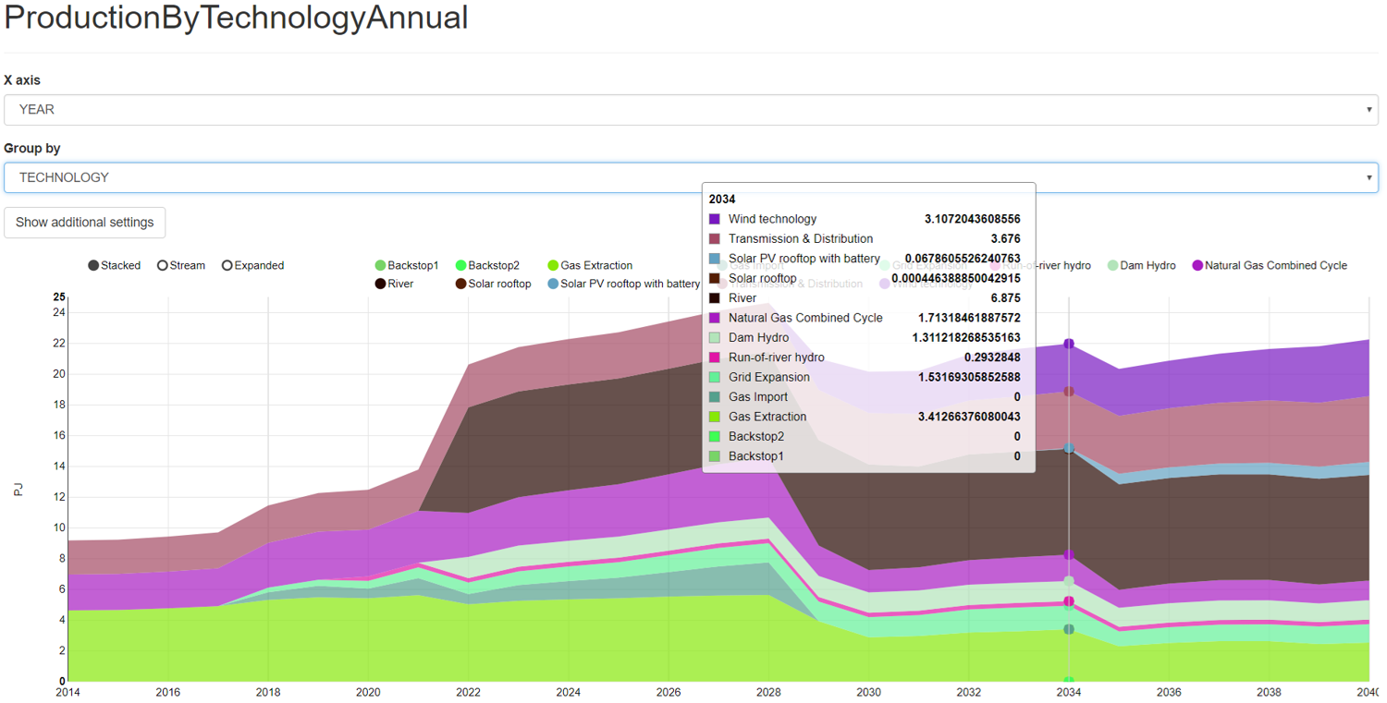
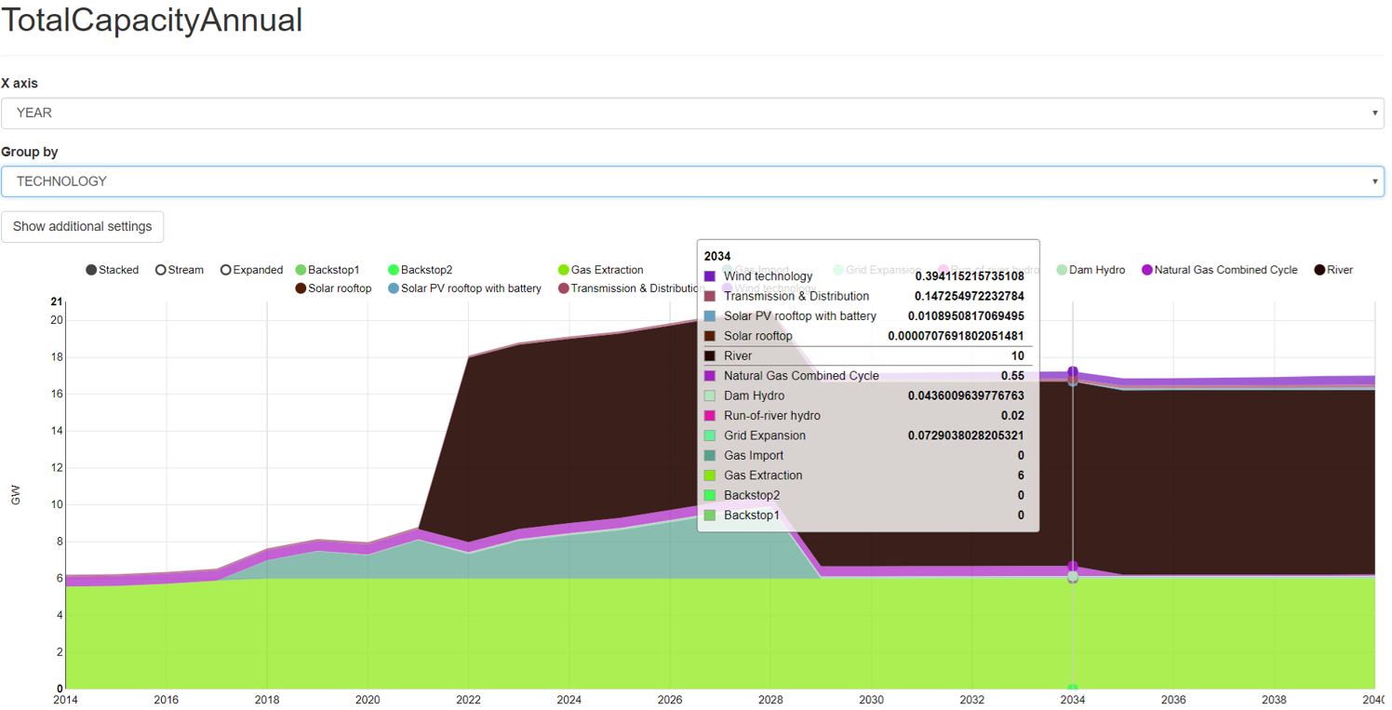
Run the model and check the results!

Slide 7
Changelog and Attribution
Date | Author | Reviewer | Reviser
2018-06-12 | Taliotis, C., Gardumi, F., Shivakumar, A., Sridharan, V., Ramos, E., Beltramo, A., Rogner, H., Howells, M. | Howells, M., Beltramo, A. | Gardumi, F., Taliotis, C.
To correctly reference this work, please use the following:
Taliotis, C., Gardumi, F., Shivakumar, A., Sridharan, V., Ramos, E., Beltramo, A., Rogner, H., Howells, M., 2018. Implementing capacity reserve in OSeMOSYS, KTH-Desa and OpTIMUS.community.
Available at: (URL). [Access date]
DOI: 10.5281/zenodo.2068953

